Slide 1
Monitoring of Buildings and Land Use Types with Remote Sensing Data
PCC Conference, Rīga, 12th May 2015

Slide 2
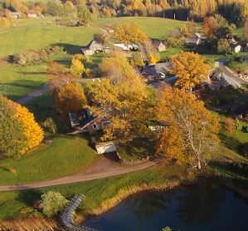
Topics
Objectives
Background
Building data
Land use
Conclusions

Slide 3

Objectives
The Future cadastre – real time cadastre (FIG 2010)
  Transition from passive to dynamic cadastre
  The most alternating cadastral data – buildings and land use
Effective procedures and technologies with new sources of information

Slide 4
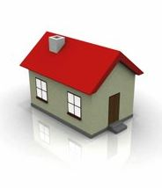
Buildings
1.4 M registered buildings
  68% from MAX survey (outside and inside)
  32% from MIN survey (outside)
  Average age of data ~ 12 years
~10 000 new buildings registered yearly
~6 000 surveys of registered buildings yearly
> 80 000 unregistered buildings estimated
Notes:
Building mass survey MIN data and registration for Real Estate Tax; minor improvements and depreciation does not come from authorities.

Slide 5
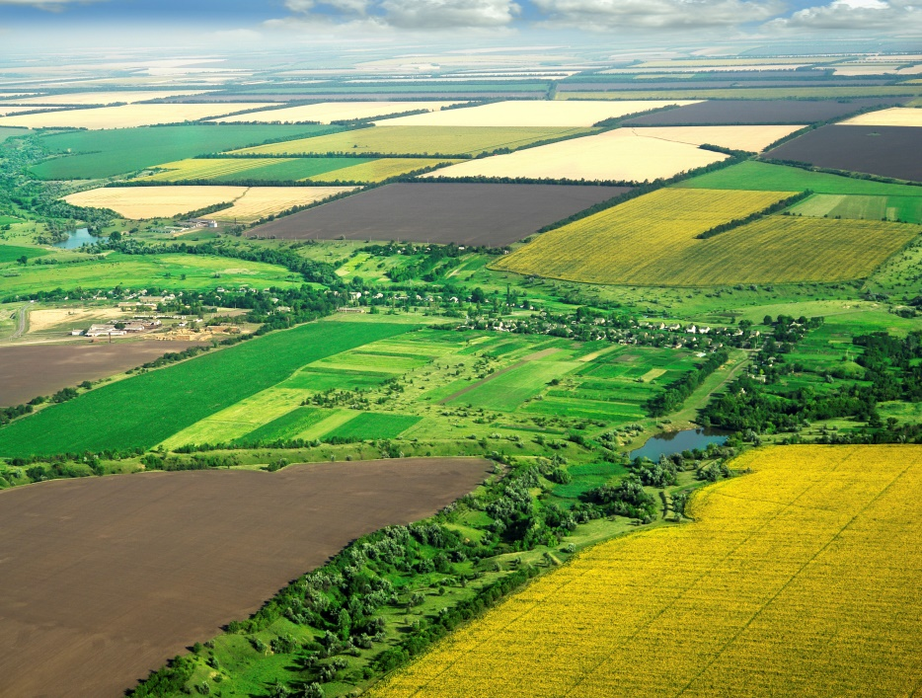
Land use
Total area 64 589 km²
1 M land parcels
Average age of data 14 years
1% new surveys yearly

Slide 6

Possible ways
Automatic procedures for updating of building and land use data
Remote sensing data analysis instead of classic survey
Standard software?
Combined approach for buildings:
  Remote sensing + owners declaration
Combined approach for land use:
  Remote sensing + other spatial IS

Slide 7

Organizational steps
Tests of ready-made software - SLS
Research of new approach for remote sensing data analysis
Universities as reseachers
  Teaching staff
  Doctoral students
  Students
Cooperation with Rēzekne University and Latvian Agricultural University from 2014

Slide 8
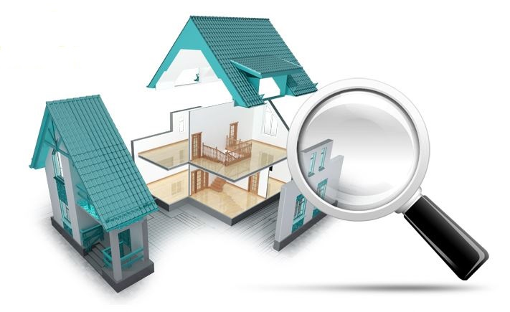
Building recogition
Tasks for recognition:
Methods
Existence of buildings
Changes of outline in comparison with cadastral map
Changes of volume
Profile and matherial of the roof - future
LiDAR and ortophotos data analysis
Energy mininization approach

Slide 9
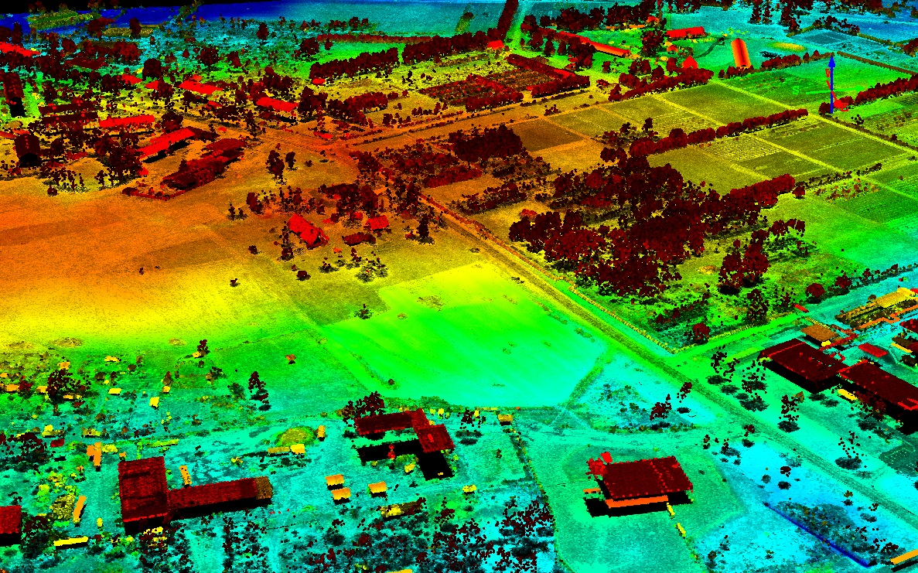
Energy minimization
approatch
Start
Point cloud
Transformation
using max-min filter
Slope method
Min-Cut/Max-Flow
Segmentation
Filter by area
Vectorization
Shapes of buildings
End

Slide 10

Owners declaration
SLS
Information of buildings from Cadastre, added by remote sensing data analysis
Regularity - period of 5 years
Owner
Information on building inside and constructions
Additional information for mass assessment of real estate
SLS
Data analysis
Selected field control
Cooperation with municipalities

Slide 11
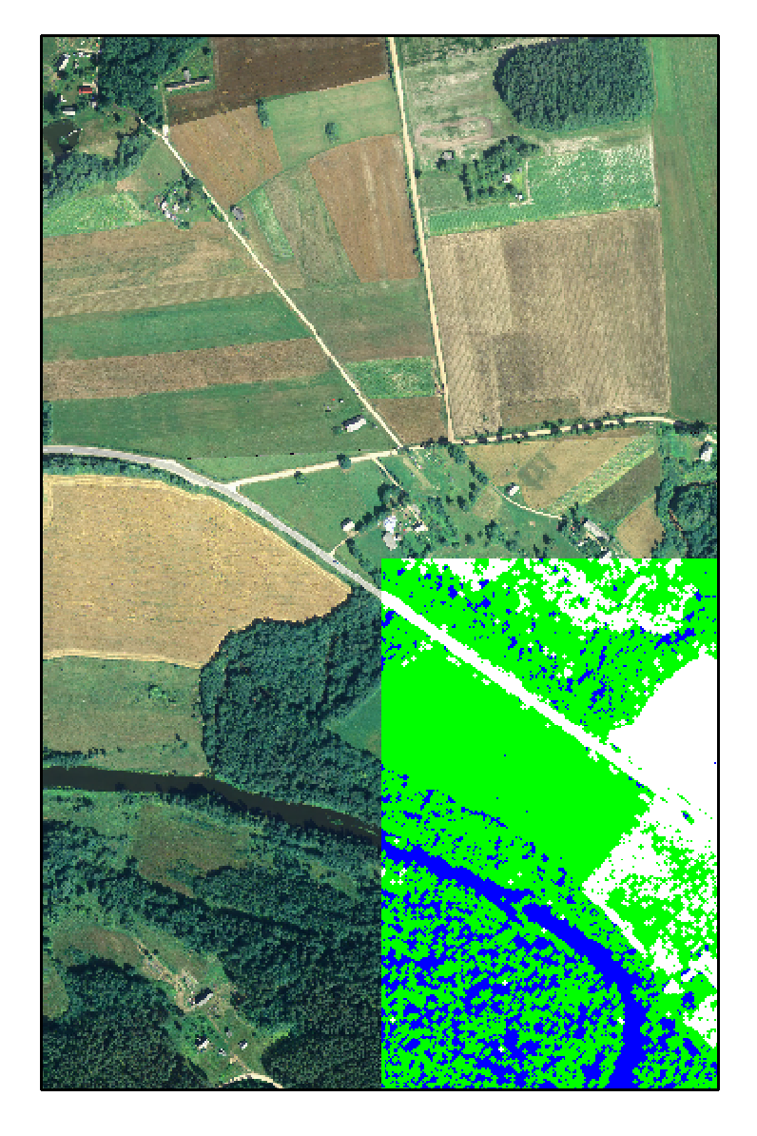
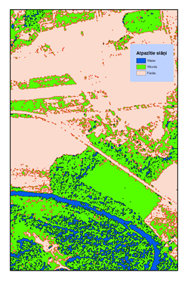
Land use
Priority – ortophoto data analysis
Additionally LiDAR data analysis
Detailed land use classification
Long term field calibration
  Additional information from other spatial IS

Slide 12

Conclusions
Automatic detection system for building and land use changes is possible
Sources of remote sensing data – from regular state financed ortophotos and LiDAR
Joint universities research structure for development of methodology and technology is necessary
Regular monitoring of buildings should consist of remote sensing data analysis, owners declarations and field inspections
Regular monitoring of land use types should consist of remote sensing data analysis and information from other spatial IS

Slide 13
Thank you!

